Slide 1
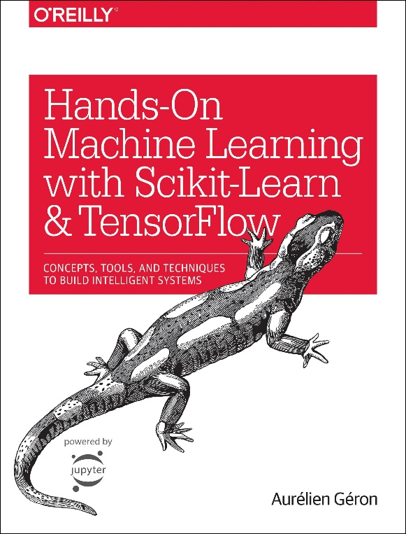

Novice Machine Learning E2E Project
Part 07
Prepare Data for ML Algorithms
Mukunthan Ragavan

Slide 2
E2E Machine Learning Project
Look at the Big picture.
Get the Data (Split the Data, Stratifying the Data).
Discover and visualize the data to get insights.
(Scatter with plot with density and color map, Correlation)
Prepare the data for ML algorithms. (Data Cleaning)
Select a model to train it.
Fine-tune your model.
Present your solution.
Launch, monitor and maintain your system.

Slide 3
* Most Machine Learning algorithms cannot work with missing features. *Cleaning/Imputing the missing the fields. * Understanding the fit and transform.

Slide 4
Coding in action !

Slide 5
Thanks All for watching and your subscription !

